Slide 1
TallyCare Training TallyPrime Rel 4.0

Slide 2




Major Deliverables
TallyPrime Integration with WhatsApp
Dashboards
Enhancement / Defect fixes delivered in
TallyPrime Rel 4.0
Import from Excel

Slide 3
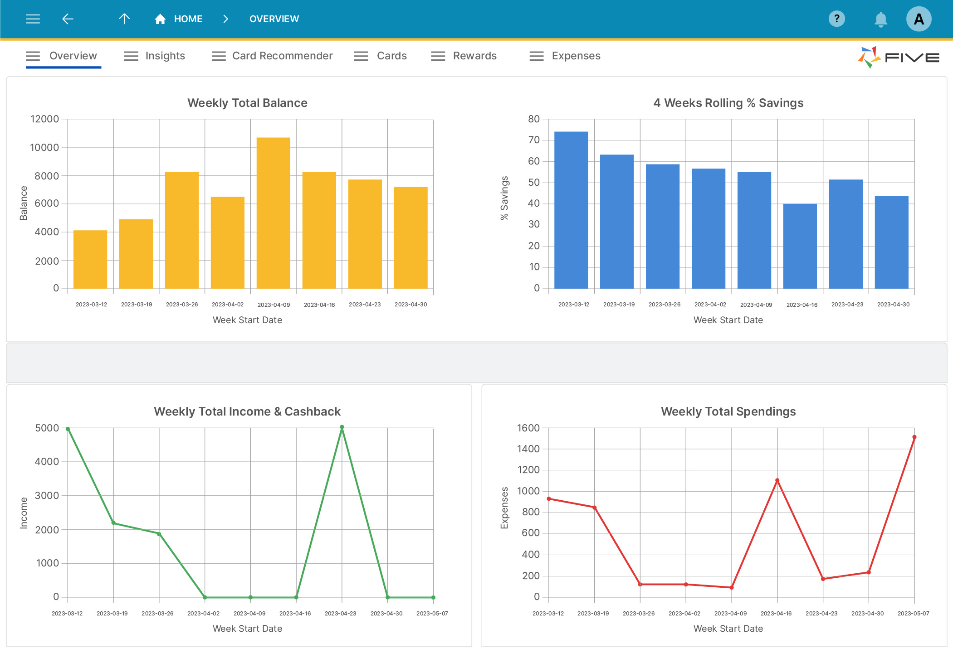
Tally Dashboard

Slide 4


Overview
Introduction to Dashboard (What, Why & How)
A few business scenarios to understand Dashboard
Various Navigation Methods to Dashboard
Security & Data Interchange
Reports or Information that will not be available on the Dashboard
Benefits and Value for Users
Product Walk-through
Tiles
Date / Period
Operations / Menus in the Dashboard
Out of Scope for Release 4.0

Slide 5
Tally ‘Dashboards’ caters to all your important business information on a single interface, that allows quick analysis of business health by providing all the financial and inventory information and trends from across 350+ Tally reports.
There are unique ways in which user wants to see the information about how they run their business and what needs attention. With ‘Dashboards’ in Tally we help business owners to get a better overview of their business the way they want to, that allows.
DASHBOARD
Quick access to critical business data that makes decision-making faster and more efficient.
INTRODUCTION
Instantly view business insights, saving a lot of time spent in manually extracting from the data available in the wide range of reports.
Completely customizable dashboards with the ability to drill down, modify (Add or remove information) and save views.

Slide 6

Navigation
Tally provides a pre-created dashboard with the commonly accessed data points by most of the business or users. This Pre-defined dashboard can be modified by users to add/remove the details as per the business need and save it for subsequent access.
Pre-defined dashboard can be navigated in the following ways.
GoTo
Saved viewed – Predefined Dashboard
Common Reports - Dashboard
F1:Help > Setting > Startup >Open Dashboard on loading a company
(Esc to load GWT)
Gateway of Tally > 'Dashboards'
Dashboard - Change view which are saved by the user

Slide 7
Benefits / Value for users
Quickly add or remove the tiles based on the need of analysis.
Different pieces of related information are brought together and displayed in the form of Pre-defined tiles, which can be modified to show the values as required by the user.
Visual representation of trends and comparisons, that allows quick and easy to analyze large volume to data and identify exceptions in no time. (Using bar graphs)
Share dashboards with different stakeholders of business, simply by saving a dashboard for everyone or Email/print/WhatsApp to view it outside Tally.
Customizable dashboards that allow to add or modify the details as required by the business/user and save it for future reference, thereby facilitating single-click access to the data that is analyzed on daily basis.
Multiple Pre-defined dashboards to meet diverse analysis needs of different departments/ users of the business-like Business Overview, Sales dashboard, Purchase dashboard
Make your preferred dashboard as a home screen of Tally that allow you to always be on top of your business data.

Slide 8
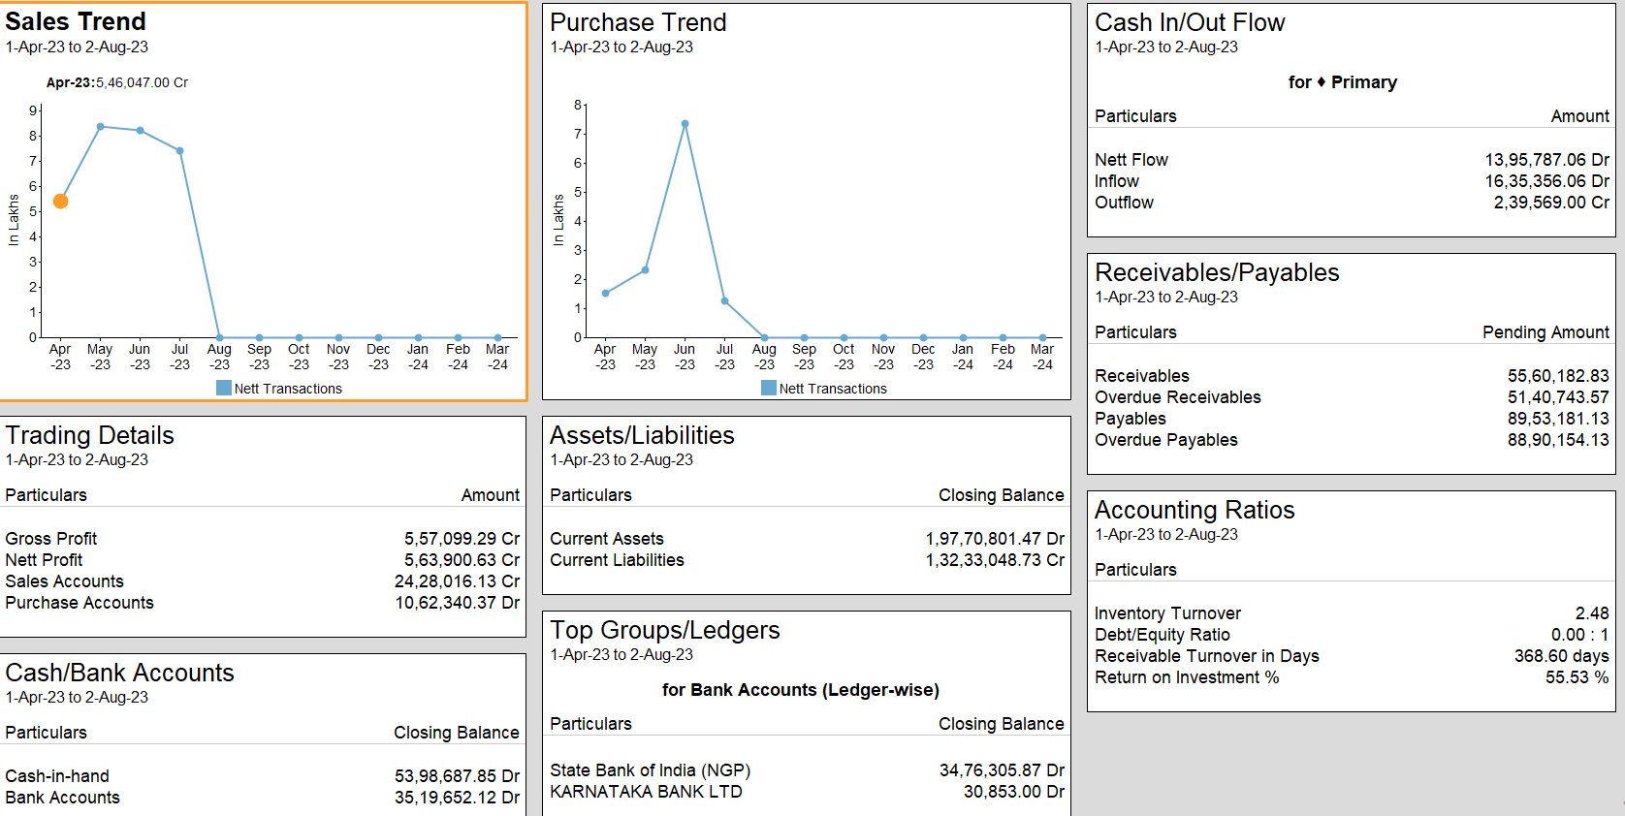
Product Walk-Through - Tile
All these boxes are called “Tile”. Each tile is independent and can be customized as per customer needs. Each tile data represented can be changed either in Data or Graphic or both if needed
We can add or remove tile from the Predefined/ Default Dashboard or user saved dashboards.

Slide 9
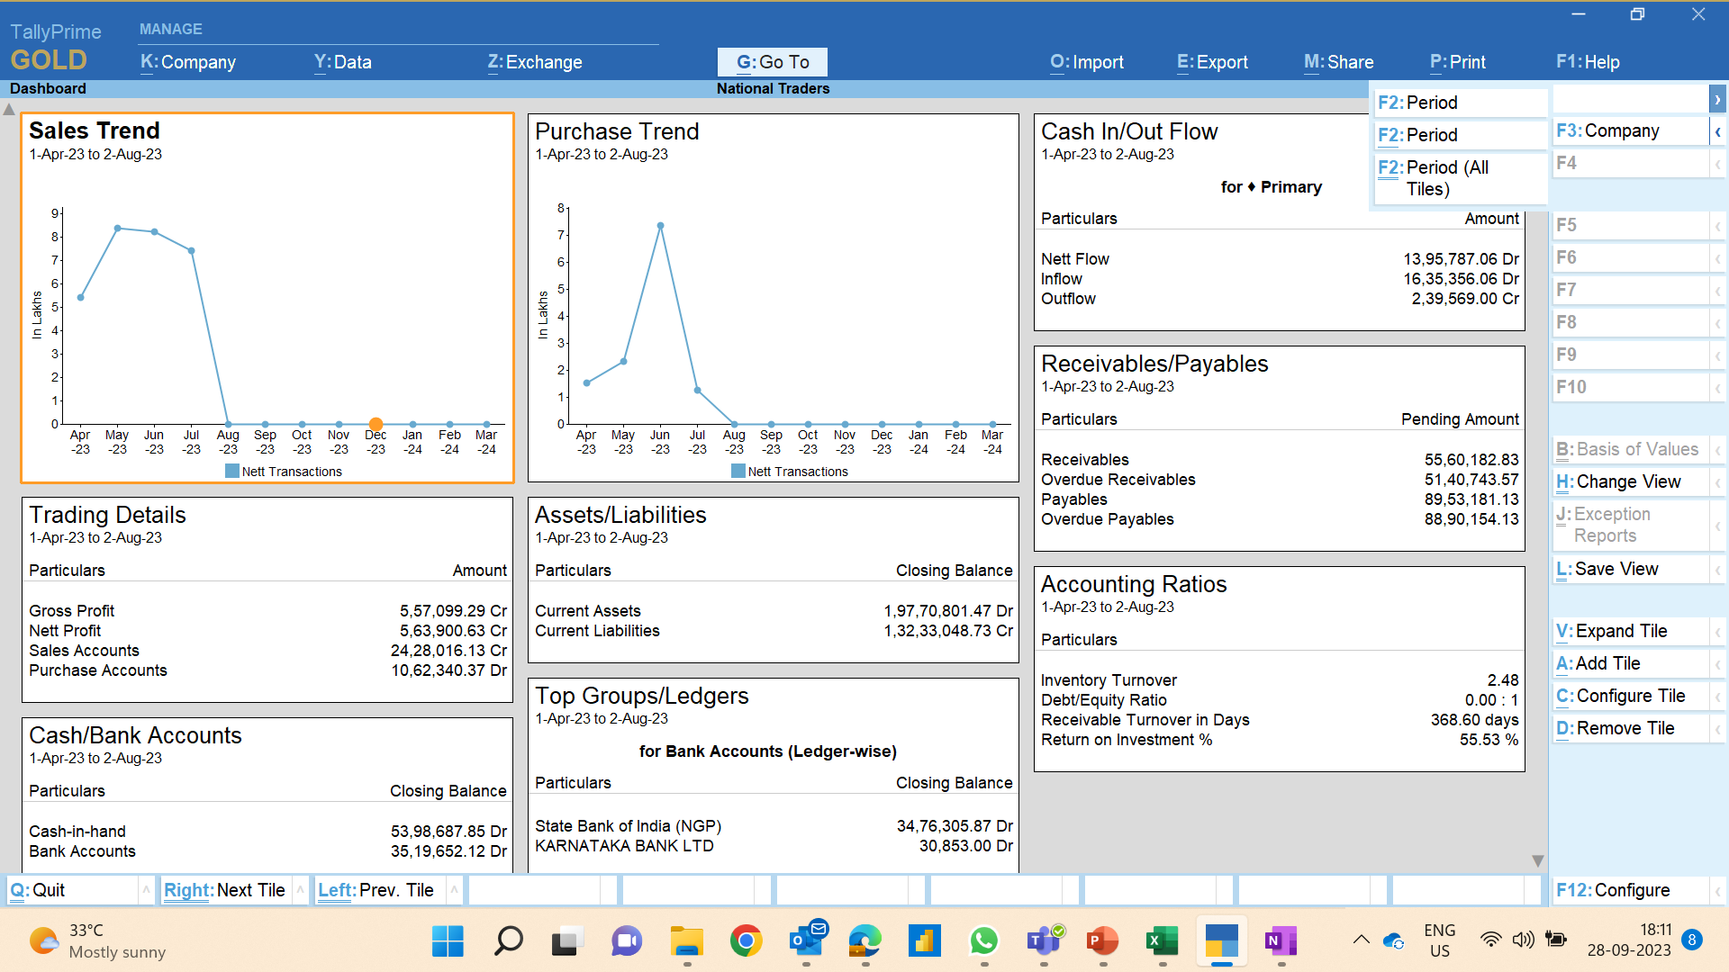
Product Walk-Through – Date/Period
Dashboard will by default open for the current month (based on the last voucher date month).
Period in the dashboard is at tile level, which means there is no period for a dashboard, depending on the period configured for each tile the data will be displayed.
3. F2:Period / Alt+F2: Period – Helps in configuring period for specific Tile and the period of a few Tile might vary based on style
4.Ctrl+F2: Period (All Tiles): This will help in applying period for all tiles in one short may be quarterly or monthly or period whatever is required.
Arrow down and up to scroll down or up in the dashboard

Slide 10


Product Walk-Through – Operations in the Dashboard (1/2)
CONFIGURE TILE
ADD TILE
Make a big impact with professional slides and charts by adding Alt+A required tiles
Configure tile from the dashboard
On clicking the right button Alt+C, a configuration screen will be opened containing the list of details that can be -
a) Add or remove the information to the tile and other set of configurations will allow to see additional details for the information added to the tile
b) The defaults of these configurations will be preset based on the commonly used information of the users.
One tile can be configured at a time
One tile can be added at a time
A given tile may have multiple information, hence same tile can be added multiple times with different Titles.
Notes:
Add Tile: E.g. A revenue tile may have details about sales, purchases, direct incomes, expenses, etc. User may want to see sales information in one tile and purchase details in the other. Hence flexibility is provided to add same tile multiple times to a dashboard and configure each tile to show only required information.
E.g. Considering the above case, if user adds revenue tile more than once, then from second time onward system will add the tile with name as Revenue-1, Revenue 2,...However, if user wants to give his own name for easy identification he can do so by altering the tile.

Slide 11


Product Walk-Through – Operations in the Dashboard (2/2)
REMOVE TILE
EXPAND TILE
Removal of tile can happen through a right button Alt+D ‘Remove Tile', and on clicking it, the tile that has focus will get removed.
Ctrl+V: Expand selected tile in larger view
User can access the Expand tile through a right button called "Expand tile" (CTRL+V) placed above Add tile without any space. It will bring focus based on where the cursor is placed.
Once removed & any modifications to the tile will also be re-set to default. If user add the tile again, it will get added with the default settings.

Slide 12
Business Use cases - Dashboard
How to Compare Trends of Stock Items Under a Stock Category Using Dashboard in TallyPrime - When the user wants to compare the trend of two different items belonging to the same category. Eg: Samsung TV and LG TV of the category Television.
How to Compare Sales in Cost Centres Using Dashboard in TallyPrime? - If user wanted to compare Zone wise sales trend (Eg: North, South, East, West): Here, company can have Zone as Cost centers.
How to Compare Sales in Groups Using Dashboard in TallyPrime? - If user wanted to compare Zone wise sales trend (Eg: North, South, East, West): Here, company can have Zone as Ledgers/Groups
How to Identify Top Cost Centres Using Dashboard in TallyPrime? – User wanted to know who are his top 5 salesman who are performing well in his company.1. These salesman can be created as Cost Centres
How to Identify Top Ledgers Using Dashboard in TallyPrime? - As a business head who are top buyers or sellers for the company. These buyers or sellers are created as Ledgers in the company
How to Identify Stock Items with no Movement Using Dashboard in TallyPrime? - Assume user wants to know what the non-moving items in his company for a given period
How to Identify Top Groups with Highest Sales Using Dashboard in TallyPrime? - As a electronic store, I handle in multiple brands, eg: Samsung, LG, Sony etc. Now I want to know which are those top 5 or 10 brands which are having highest outwards so that this help me in taking business decisions. (All these groups can be created under Primary Group.)
How to Compare Gross Profit Trend for Financial Years Using Dashboard in TallyPrime? - As a owner I want to compare what is my trend of gross profit in the current year vs previous year

Slide 13
Out of Scope for Release 4.0
Any settings that are configured at each tile level in the display report shall be carried even to the printing of the report.
Provision for the user to print/export/email the overall dashboard and not at each tile level.
Drag and Drop using mouse and Keyboard-based tile movements.
Few reports which are not considered as part of the Dashboard –
Interest Calculations / Reorder Status / Bills Pending / Payroll / Payroll Statutory /
Cheque Status/movement Analysis / EWB / e-Invoicing / Statutory reports
Minimize the difference between lengths of tile columns during the addition of tiles (i.e. adding tiles to the column with the least length)
Keyboard-based tile reordering with above/below/left/right tiles.
Dashboard Access on TRiB

Slide 14
Enhancement / Defect fixes delivered in
TallyPrime Rel 4.0

Slide 15

GSTR 1 / GSTR 3B Support
GSTR-3B quarterly return support for IFF return filers
In GSTR-3B, under all other ITC drill down need GSTIN column
IMPS (Service) exempt transactions are participating in 3.1D of the GSTR-3B Report.
Taxable value is getting doubled in GSTR 3B while checking in Nature view when purchase from an Unregister dealer recorded with RCM enabled.
GSTR-3B
Unable to Export GSTR 1 in case data is imported from other software or Excel
HSN Summary: should send "OTH" instead of NA for stock without units. Status gets detected as Uncertain when UQC is NA.
GSTR 1 Export - Total Value is not getting exported to HSN Summary
Cancelled voucher count is not captured in the document summary under the GSTR-1 report.
Uncertain Detected for Bill of Entry duplication has been removed.
Job order out voucher printing primary GSTIN irrespective of selecting the secondary address
Tally crashes while loading GSTR-1/GSTR-3B. Due to the length of the HSN description mentioned in the GST classification.
GSTR-1

Slide 16
GSTR-3B quarterly return support for IFF (1/2)
Invoice Furnishing Facility (IFF) is a facility provided to quarterly taxpayers who are in the QRMP scheme, to file their details of outward supplies in the first two months of the quarter (M1 and M2), to pass on the credit to their recipients. IFF consists of the following Tables of FORM GSTR-1:
FORM GSTR-1:
4A, 4B, 4C, 6B, 6C – B2B Invoices
9B – Credit/ Debit Notes (Registered)
9A – Amended B2B Invoices
9C – Amended Credit/ Debit Notes (Registered)
FORM GSTR-3B:
Outward supplies - This is auto-populated from FORM GSTR-1. Positive values shall be reported in respective tables. Negative values, if any, shall not be considered in the table and the system will provide the value as zero.
Inward supplies – This is auto-populated from FORM GSTR-2B. Positive values shall be reported in the respective table. Negative values, if any, shall not be considered in the table and the system will provide the value as zero.

Slide 17
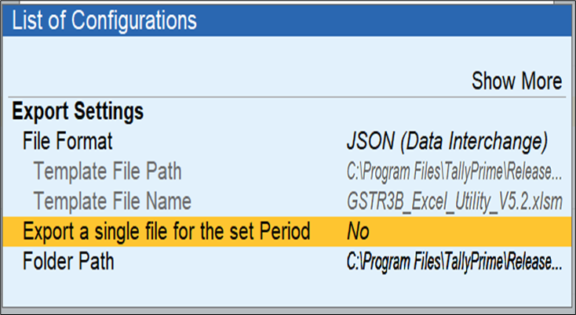
GSTR-3B quarterly return support for IFF (2/2)
Solution enhanced in Release 4.0
In the GSTR-3B preview report, in the export landing page a new configuration as an Export single file for the selected period has to be provided.
If the file format is other than JSON, this configuration will be greyed out.
This configuration has been supported in three places
F12 Configuration
Export the Landing Page of GSTR-3B
In GSTR-1 preview report - Right button → GSTR-3B → its toggle button
GSTR-3B Exchange is not supported at the Remote end, hence this new configuration will not come.
Export of GSTR-3B in Excel format is not supported

Slide 18
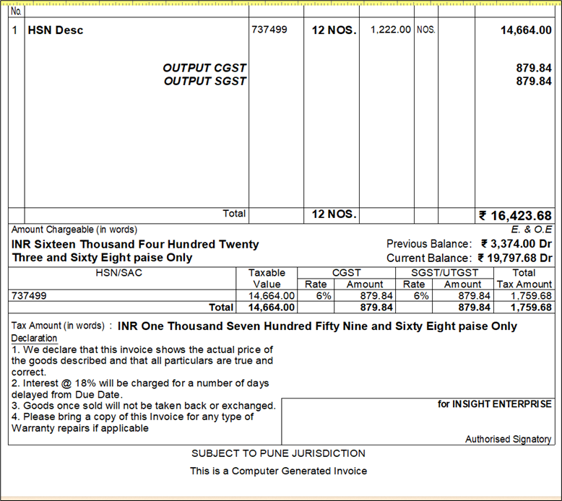
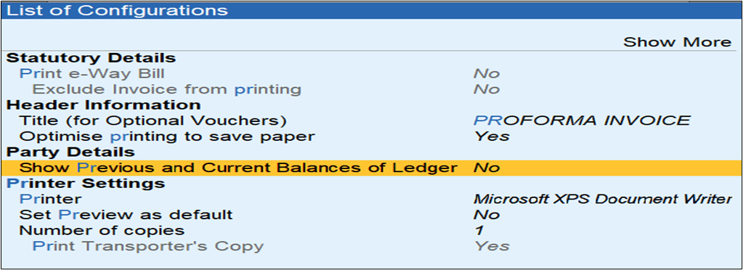
Major enhancement – Party outstanding balance
The previous balance of the party ledger or outstanding is to be shown in the invoice as of the date
Printing of Party ledger balance is supported in a Simple and comprehensive format
Printing outstanding balance is supported for Sales (All modes), Credit Notes (except voucher mode), and Debit Notes (except voucher mode).

Slide 19

e-Invoicing / e-Way Bill
e-Invoicing
e-Way Bill
On printing the multi voucher along with invoice QR code and e-way bill annexure page, the QR code of e-invoices from the second page is not getting printed.
e-Invoice is getting rejected with the reason "The ValDtls field is required“
NOTE: The same error shown resaving of the item master is required to get the proper values in exchange
Invalid GSTIN error is detected for Consignee GSTIN (If registration type is set as Government entity), E-invoice generation fails and unable to accept such transaction using Accept GSTIN/UIN – This is resolved and accept as is also allowed.
QR Code is not showing in simple Invoice when GST is disabled in F11
Unable to generate e-Invoice for intrastate transaction when e-Way Bill for intrastate is disabled from F11
Print configuration for EWB should be specific for the Invoice and not all the invoices while using Print EWB with Invoice" in F11 and Print EWB to Yes in F12.
Transaction type is captured based on the consignor address mentioned in the EWB sub-form when the e-invoice is generated along with EWB. E-invoice details need to be considered on EWB print.

Slide 20
Enhancement / Defect fixes
Other Taxation
Data Management & Performance issues
E-TDS/TCS as per new FVU Tool version 8.2 to be supported in Tally
Marginal Tax Relief value should not be shown for Regular Tax Regime opted employees
Performance Issue in Node Machine while selecting order no. of Party in delivery Notes Voucher.
MAV error while synchronization
Data migration to Rel 3.0 getting error Software exception c00000fd (Stack Overflow)
Stock Item HSN code, HSN Description, and Party GSTN Number is not getting through ODBC
Record insertion failure in voucher entry due to FLD_CMP_VCHSTATID being trailing(stale) or missing
Payment Request
Payment Request – To allow the generation of link/QR codes for cash transactions
Payment Request - UPI QR Code should allow partial payment option to payers
Payment Request - On Voucher Save - prompt to generate a link to be first in a sequence

Slide 21

TallyPrime Integration with WhatsApp

Slide 22




Overview
Customer Benefits
Introduction
System set-up
flow
Product
Walk-through

Slide 23
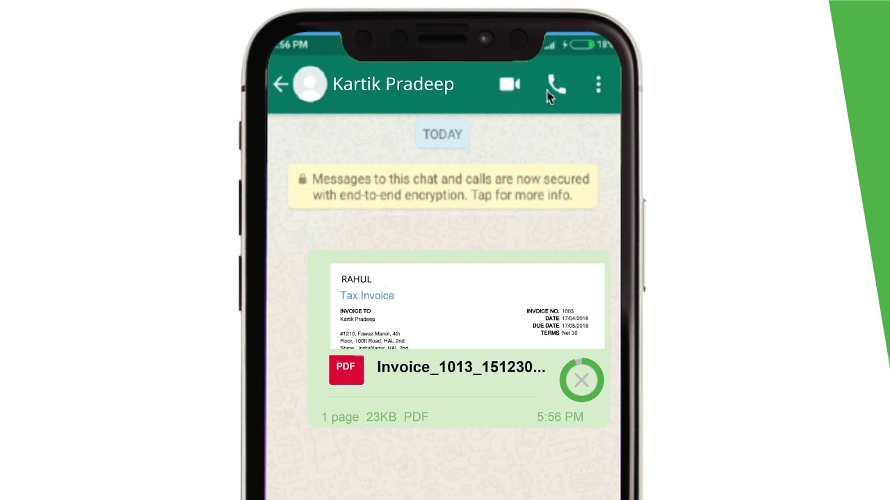
Facility to share your business documents such as vouchers and reports through WhatsApp instantly.
INTRODUCTION TO
WhatsApp

Slide 24





Customer Benefits
Share invoices & reports quickly in a convenient way
Mass message support
Share reminders, payment links with customers.
Create Message template and attach to invoice or reports
Use for sharing Marketing & other communications directly from account

Slide 25






WhatsApp Integration system flow
User must have TallyPrime 4.0 with active TSS
Add registered WhatsApp number in TallyPrime
Register on Facebook Business Manager account
Set-up Interakt account with help of Tally Partner.
It is Subscription based purchase. User can send request to partner from CC
Receives the WhatsApp login credentials from Interakt post subscription
Ready to share invoices & reports

Slide 26


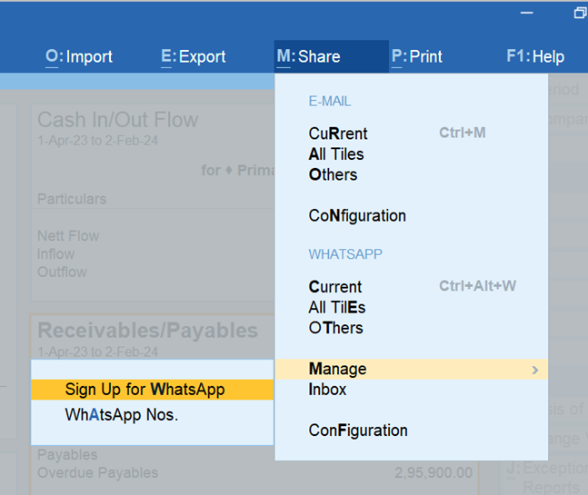






WhatsApp Integration system flow
Tally has partnered with Interakt to facilitate WhatsApp messaging
Onboarding customers to Interakt is currently handled by partners
Customers can place the request for WhatsApp feature from Web control center by following below steps
Partner will receive the lead request in CRM and assists customer to onboard to Interakt

Slide 27
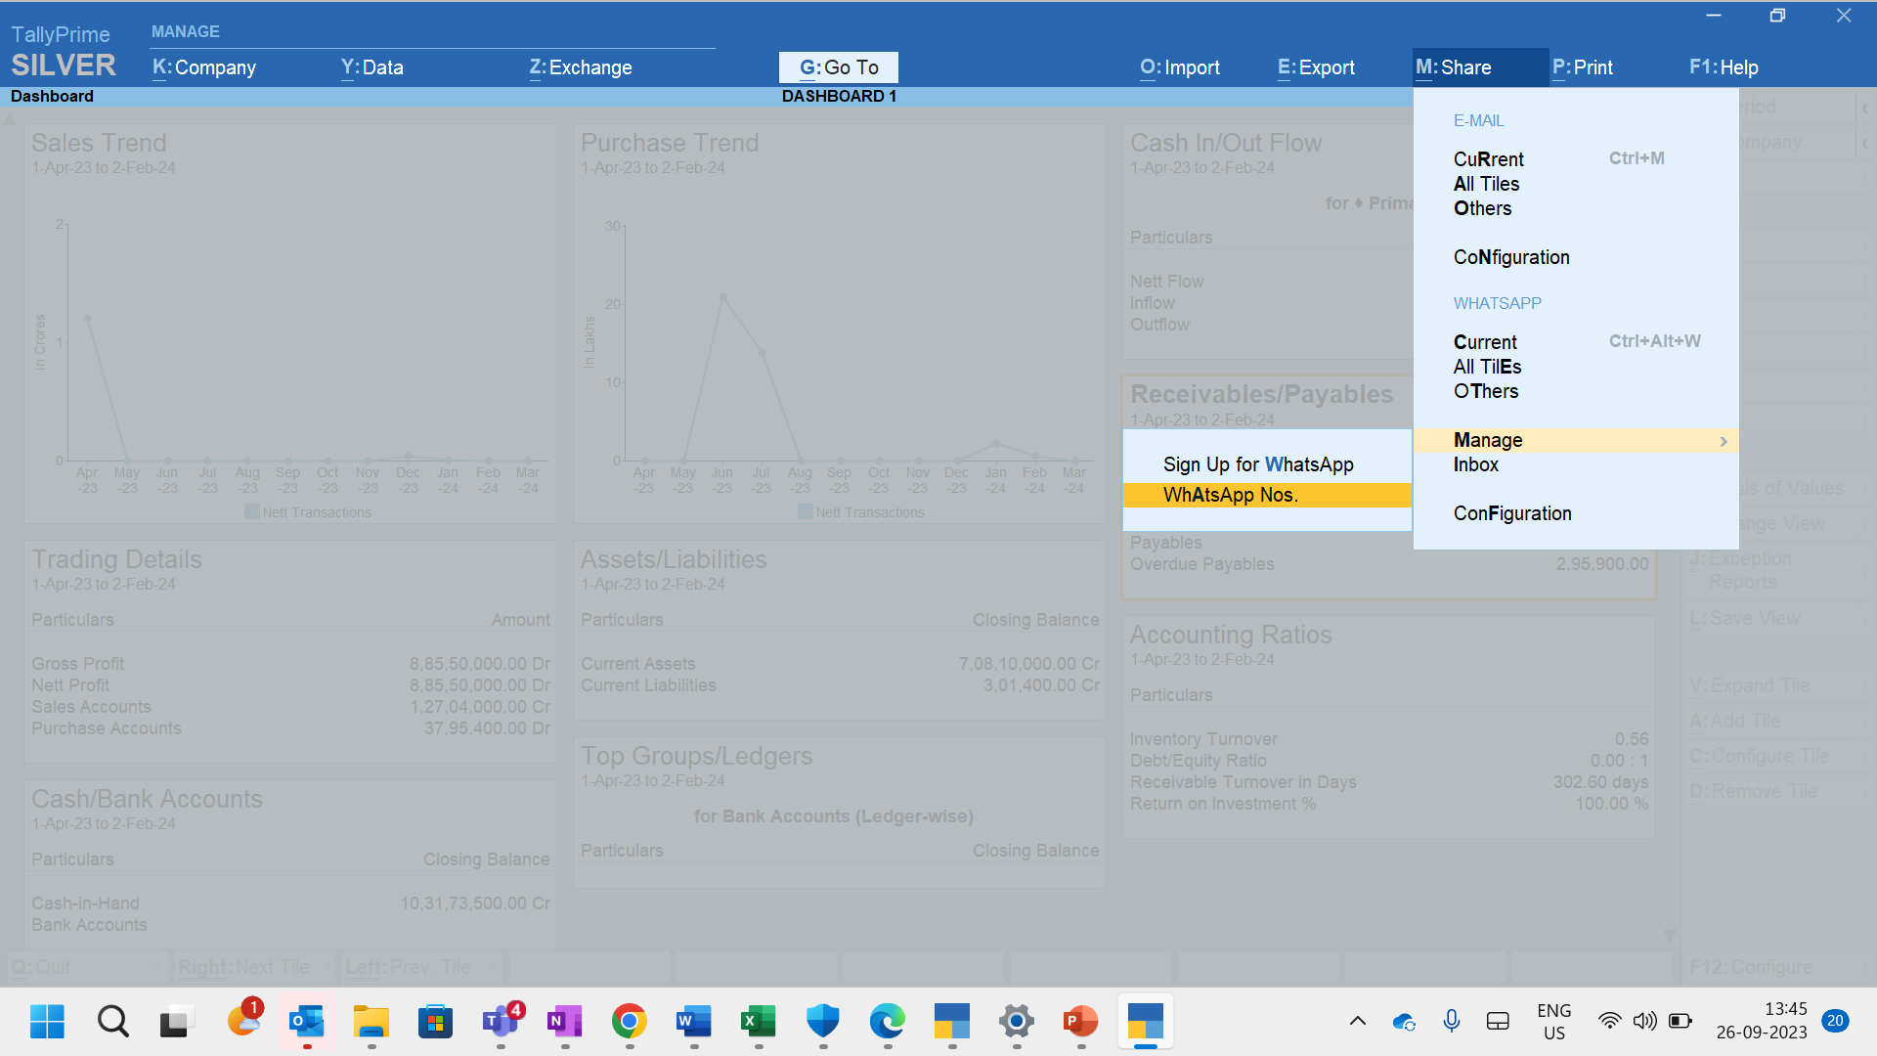
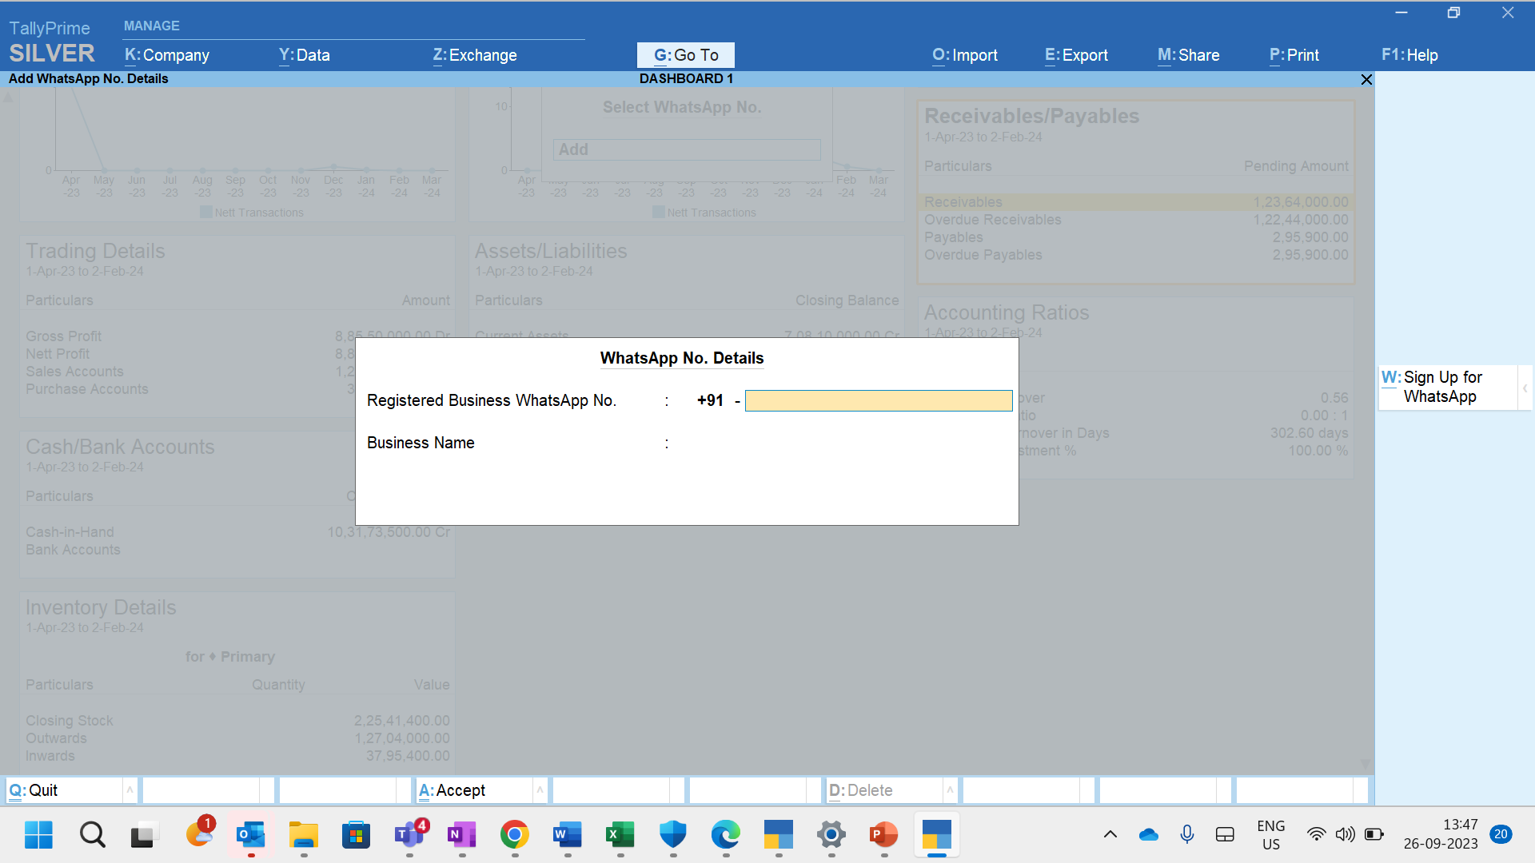
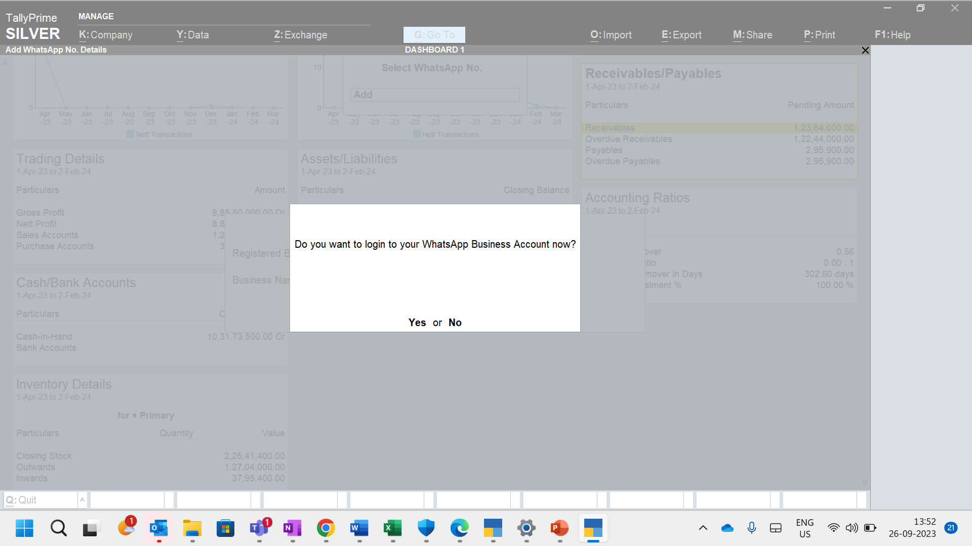
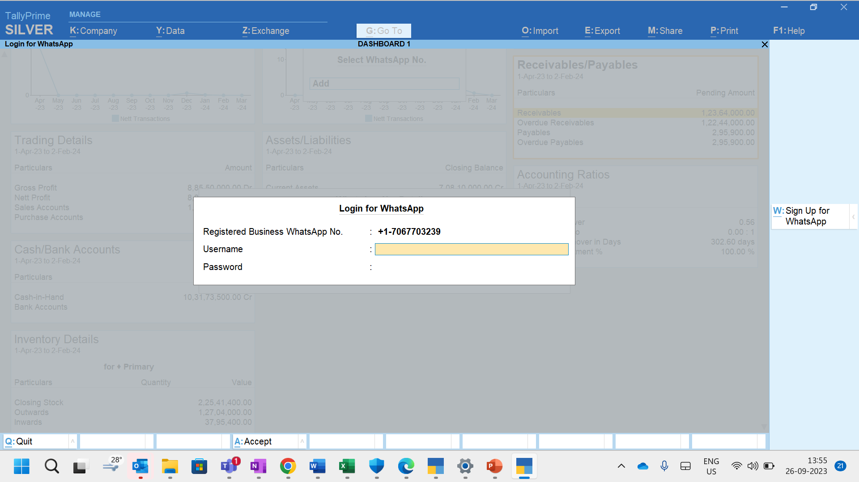
Step 2: Register the WhatsApp number in TallyPrime

Slide 28
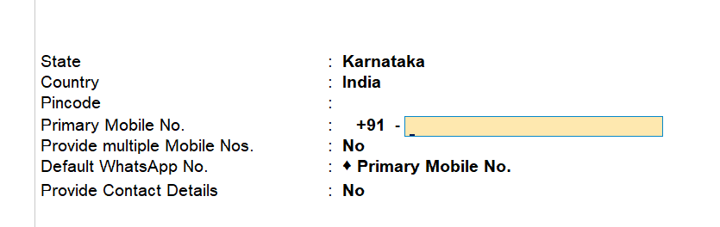
Step 3: Add WhatsApp numbers in Party ledgers
Till 3.0.1. only Mobile number field was available
In 4.0. user can specify Primary mobile number as well as secondary numbers for contact
Primary mobile number or multiple mobile numbers configured can be used for printing, exporting
Default WhatsApp number can be one or multiple

Slide 29
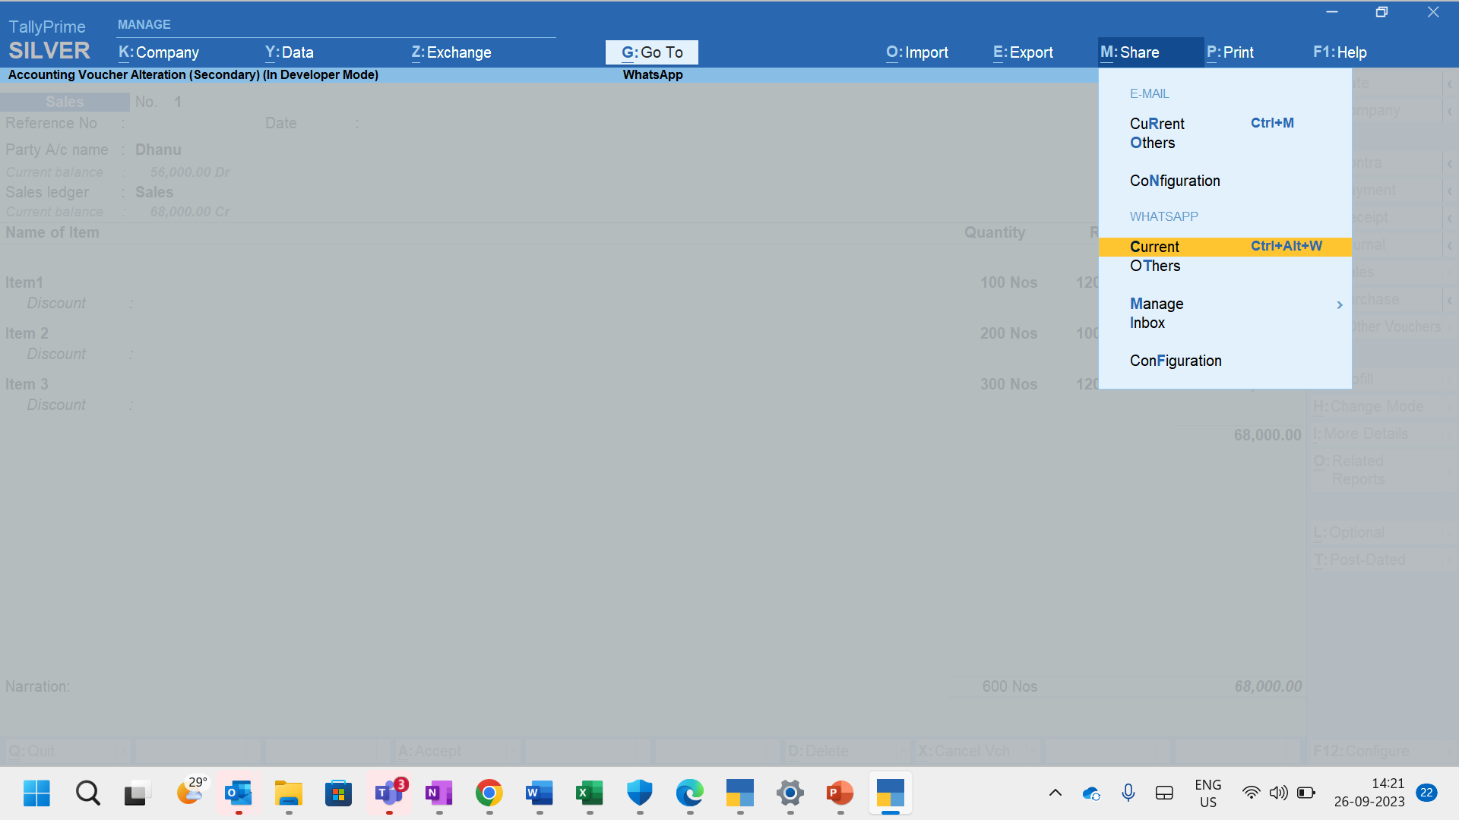
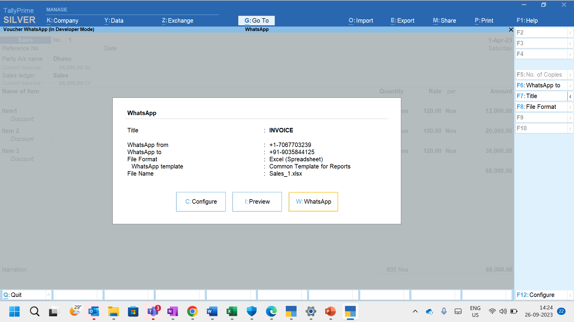
Step 4: Sharing Invoices & Reports from TallyPrime
From Voucher/Report screen, navigate as below for initiating msg –
Supported file formats are –
Excel\JPEG\PDF Only

Slide 30






Other important capabilities
Share Dashboard – One or all tiles
Set-up Security control for using WhatsApp
WhatsApp invoice after saving
Add templates to use in messages from Interakt portal
Send invoices with Payment link & Digital signature
Send documents to all ledgers

Slide 31
Out of scope requirements anticipated from Market
Scheduling the messages

Slide 32

Import from Excel

Slide 33




Overview
Pre-requisites
Key Features
Introduction to Excel Import
Product walk through

Slide 34






Pre-requisites to use Excel feature
Excel Import feature is supported from TallyPrime Release 4.0 onwards. Customers must upgrade to use this feature
All xls and xlsx from excel 97-2003 is supported to experience Excel Import feature
Customers who are using Excel Customization should perform few modifications before using Excel Feature in 4.0

Slide 35
INTRODUCTION
Maintaining data in Excel is quite common for -
Microsoft Excel is known world-wide for its wide-usage for data recording and analysis.
According to surveys, more than 1 billion customers use Excel worksheets to maintain records related to financial accounting and related services.
TallyPrime brings in a seamless experience to import all your data from Excel.
Keeping records of the daily purchases and sales in businesses.
Maintaining financial transactions like payments and receipts.
Logging price lists, sales or purchase orders and so on from dealers and vendors.

Slide 36

Key Features of Import from Excel
Pre-defined Excel template
To easily maintain records of daily your transactions and import them all in the click of a button.
Mapping options
To match the way, you maintain records in Excel and make it compatible for a seamless import.
Preview summary before importing
To ensure accuracy and reliability. TallyPrime just does not import any data without your knowledge.
Notes:
This helps in organizing all the masters and transaction records in a specific way and move them all through the Import feature in TallyPrime in one shot.
You record transaction in your own way depending on the need, which could be much different from the regular fields in masters and vouchers in TallyPrime. Map your way in Excel to fields available in TallyPrime and you are all set. Import takes care of moving the data entries from your Excel fields to the master and voucher fields, exactly as per the mapping.
You have the choice to preview a summary of the data before importing in a Pre-import Summary screen.

Slide 37


Use of Excel Import Feature Scenario 1
Charted Accountants
/ Auditors
Will be using TallyPrime, their clients would be entering data in Excel File formats
Current Challenges
As the data is used in Excel and CA’s/Auditors will be using TallyPrime entering excel data in Tally manually and validate them for purpose of tax and audit compliance is a Tedious task
TallyPrime Release 4.0 “Import Excel” feature will eliminate the manual data entry in TallyPrime which saves the time.

Slide 38
Use of Excel Import Feature Scenario 2
E-Commerce
Customers
who have online retail businesses with Amazon, Flipkart, Ajio, Myntra & etc receive their data in Excel sheets and Auditors will prefer TallyPrime
TallyPrime Release 4.0 “Import Excel” feature will eliminate the manual data entry in TallyPrime which saves the time.

Slide 39
Use of Excel Import Feature Scenario 3
Customers
who will be using different softwares such as Quick Books, Marg, Busy, Sage etc or customized applications export the data in excel format
Current Challenges
As the data is used in Excel and CA’s/Auditors will be using TallyPrime entering excel data in Tally manually and validate them for purpose of tax and audit compliance is a Tedious task
TallyPrime Release 4.0 “Import Excel” feature will eliminate the manual data entry in TallyPrime which saves the time.

Slide 40






Customer Benefits
Customers do not require to change their excel format and their practice, and they can import the same into Tally by mapping their excel columns with Tally fields.
01
Customers not having any excel format, can use the Tally provided Templates seamlessly to enter the data and import into Tally.
02
Benefits
The data can be imported into Tally whether the account entries are recorded vertically or horizontally in Excel
03
Flexible enough to map the excel data with Tally fields, either using Excel column headers or user defined column Titles
04
05
Mapping is a one-time activity & can be used in other companies in Tally or can be shared with same type of businesses that uses Tally.

Slide 41
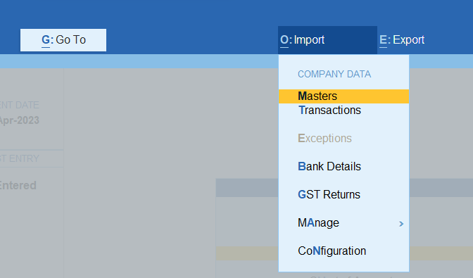
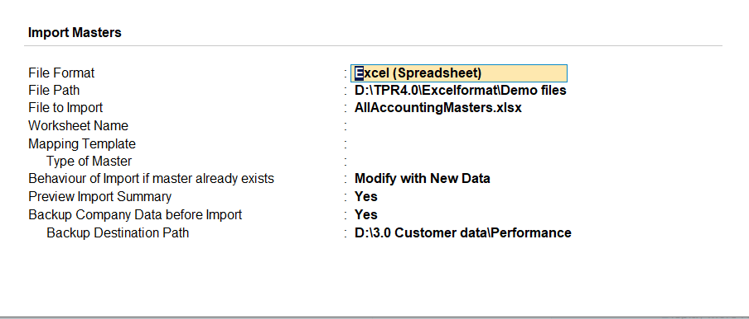
How to use Excel Import feature
From Gateway of Tally> Alt+O > Select Master/Voucher
Masters> Enter/Transactions

Slide 42
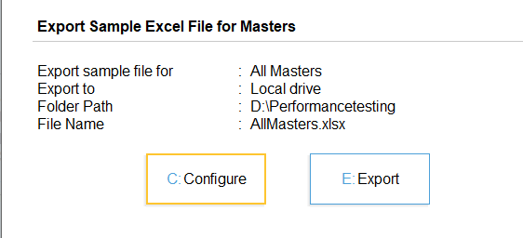
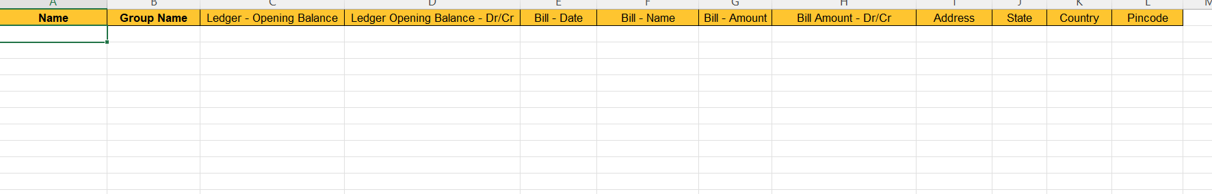
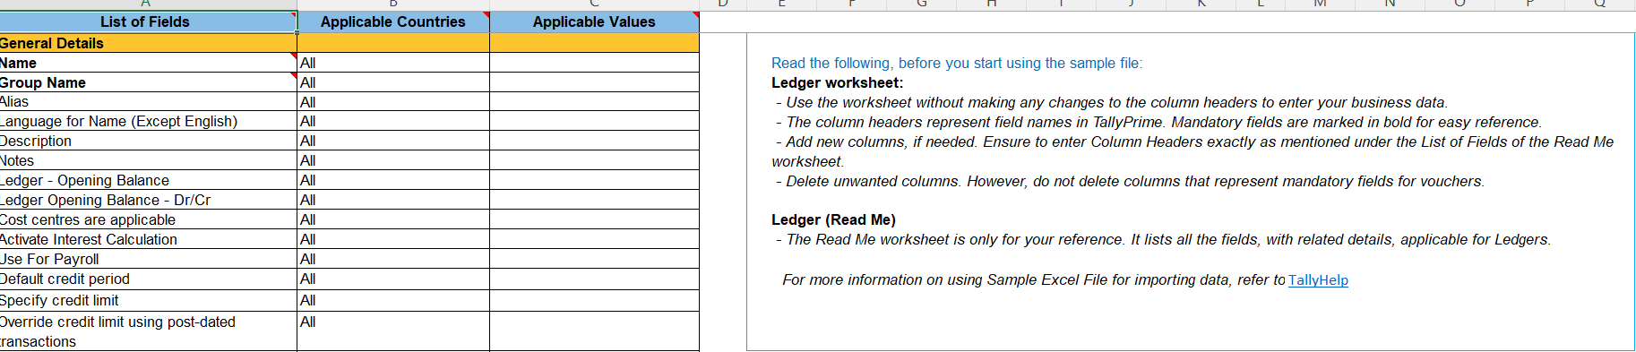
Product Walkthrough- To download Sample Excel File
To download Sample Excel File> From Import Screen > Masters/ Vouchers> ALT+L. Sample Excel File can also down

Slide 43
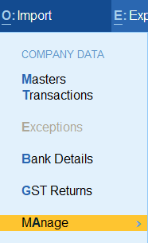
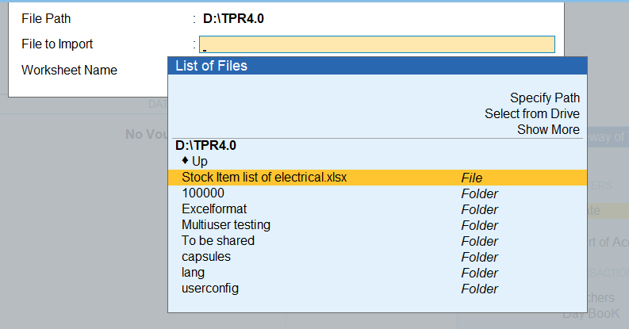
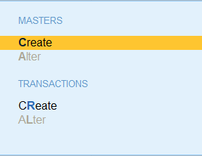
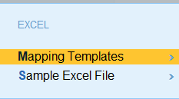
Product Walkthrough- Manage (Mapping Templates)
To Create template as per the Excel File, ALT+O > Manage> Mapping Template> Masters/Transactions> Create

Slide 44
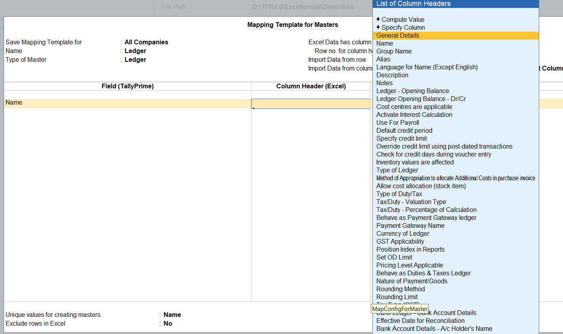
Product Walkthrough- Manage Mapping Templates 2 of 2
To Create template as per the Excel File, ALT+O > Manage> Mapping Template> Masters/Transactions> Create

Slide 45
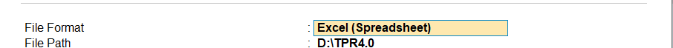
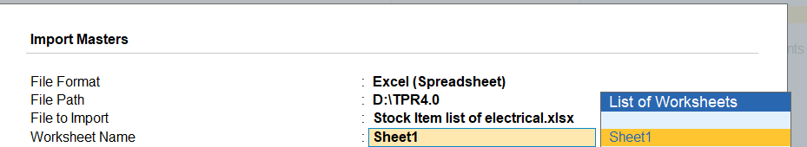
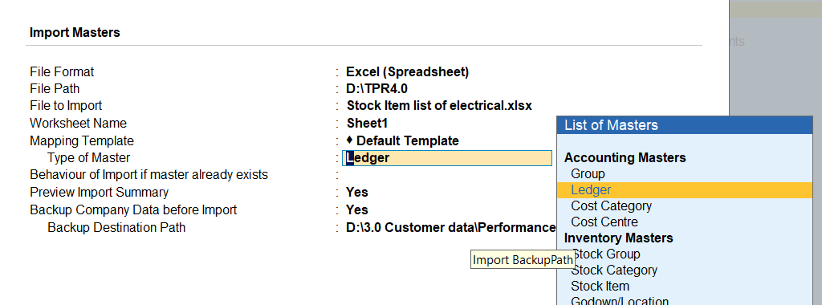
Product Walkthrough Importing Excel 1of 3
ALT+O> Import> Masters/Transactions> File format > Excel Spreadsheet> File Location (Excel File Path)
File to Format>File path> File to Import> Worksheet name
Mapping Template Type of Master

Slide 46
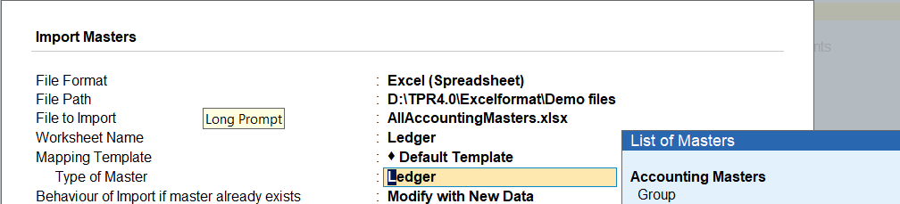
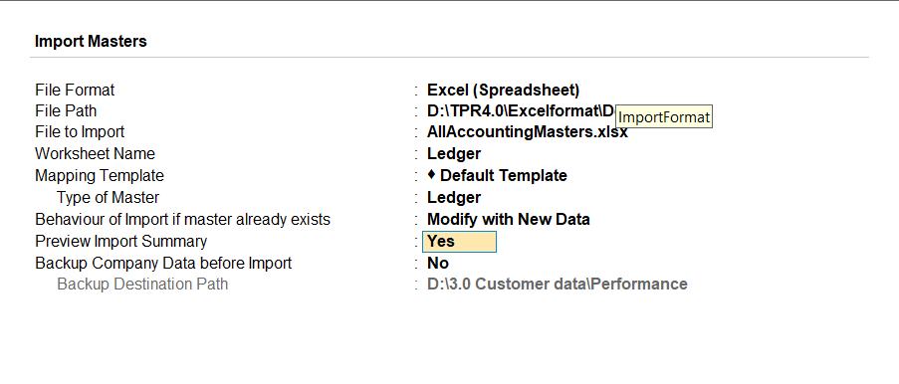
Product Walkthrough Importing Excel 2 of 3
Select the type of Master to Import> Group/Ledger
Preview Import summary to Yes
Backup Company Data before import to Yes

Slide 47
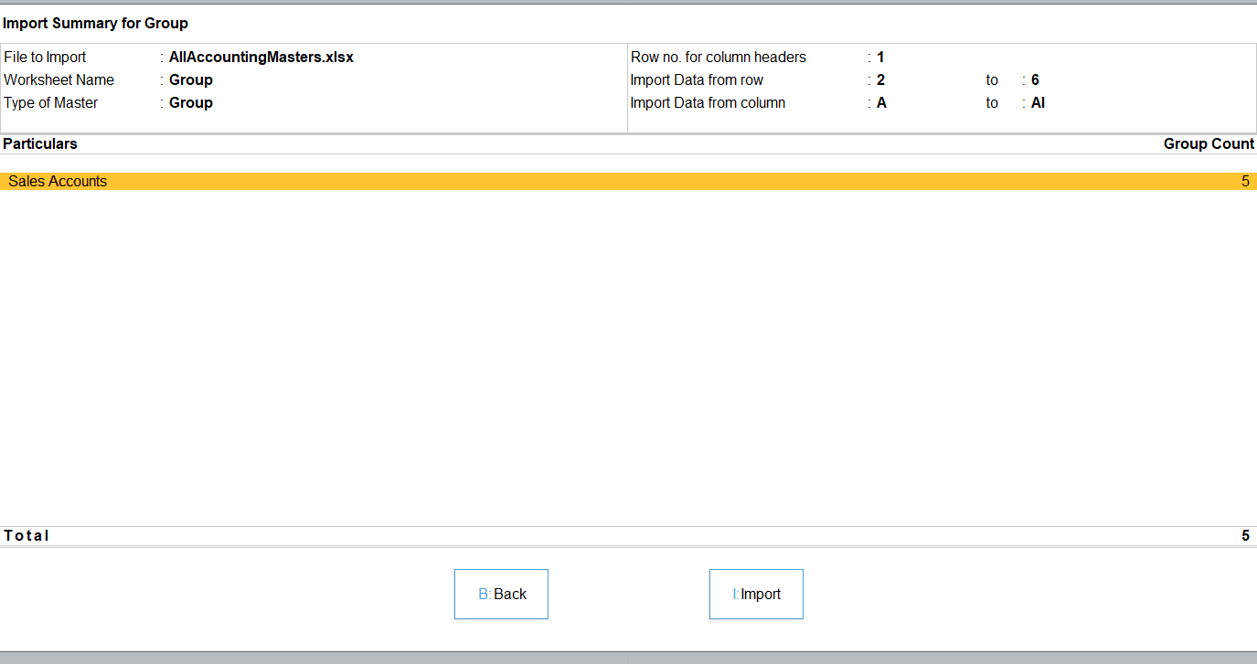
Product Walkthrough Importing Excel 3 of 3
Before Import Preview >

Slide 48
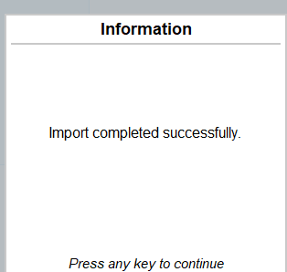
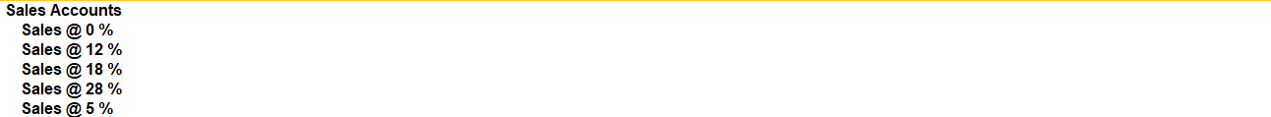
Product Walkthrough Importing Excel 3 of 3
Import the Masters/Vouchers

Slide 49
TallyCare Training TallyPrime Rel 4.0

Slide 50
Major Deliverables
TallyPrime Integration with WhatsApp
Dashboards
Enhancement / Defect fixes delivered in
TallyPrime Rel 4.0
Import from Excel

Slide 51
Q&A

